Slide 1
IMPROVED SYMBOLIC EXECUTION WITH
THE CORAL CONSTRAINT SOLVER
Marcelo d’Amorim
Assistant Professor at Federal University of Pernambuco (UFPE)
Notes:
Today I will talk about our constraint solver CORAL that we have developed with the goal of improving software testing.
<number>

Slide 2



Software errors are expensive
Software is everywhere
Annual cost of software errors to the US economy is ~60B dollars [NIST2002]
Notes:
I would like to start this talk highlighting that software is everywhere: in cars, handheld devices, and aircraft.
Unfortunately, software often contains errors which can be very expensive!
These errors can lead to catastrophes and damage the image/reputation of the organizations that develop the software.
A report from NIST in 2002 indicates that this cost can be as high as 60B dollars.
<number>

Slide 3
Main approaches for finding errors
Software Testing
  Run code and observe effects
Static Analysis
  Analyze code without running it
~20B dollars can be saved with better infrastructure [NIST2002]
Notes:
Software Testing and Static Analysis are two popular approaches for finding errors.
That same report suggests that better infrastructure for Software Testing can reduce this cost in about 20B dollars.
<number>

Slide 4
My Research Goal
Develop new techniques and improve existing techniques for Software Testing and Static Analysis
Notes:
My overarching goal is to Improve Software Testing.
My message at this point is that testing is an old technique and still very useful. Testing is here to stay. It is not just a band-aid. It will remain important as long as programming software systems remains important.
It is good to know that there are several ways to make testing more systematic (/more disciplined).
*****
Our challenge is to take advantage of the advances in CS to make testing more effective and cheaper.
*****
<number>

Slide 5
Overview of My Work
SOFTWARE TESTING
STATIC ANALYSIS
SCP’12
NFM’11
CC’11
NFM’09
ASE’11
CbSoft’10
ISSE’10
ICST’12
ASE’12
ASE’06
HotDep’07
ICST’09
ISSTA’07
TSE’08
ICSE’08
RUNTIME
VERIFICATION
RV’05
ICFEM’06
WODA’05
SIMULATION’10
CAV’05
ISSRE’12
ICFEM’04
Notes:
<number>

Slide 6
Overview of My Work
SOFTWARE TESTING
STATIC ANALYSIS
SCP’12
NFM’11
CC’11
NFM’09
ASE’11
CbSoft’10
ISSE’10
ICST’12
ASE’12
ASE’06
HotDep’07
ICST’09
ISSTA’07
TSE’08
ICSE’08
IMPROVED SOFTWARE
MODEL CHECKING
RUNTIME
VERIFICATION
RV’05
ICFEM’06
WODA’05
SIMULATION’10
CAV’05
ISSRE’12
ICFEM’04
Notes:
<number>

Slide 7
Overview of My Work
SOFTWARE TESTING
IMPROVED CONSTRAINT
SOLVING FOR SYMBOLIC EXECUTION
STATIC ANALYSIS
SCP’12
NFM’11
CC’11
NFM’09
ASE’11
CbSoft’10
ISSE’10
ICST’12
ASE’12
ASE’06
HotDep’07
ICST’09
ISSTA’07
TSE’08
ICSE’08
IMPROVED SOFTWARE
MODEL CHECKING
RUNTIME
VERIFICATION
RV’05
ICFEM’06
WODA’05
SIMULATION’10
CAV’05
ISSRE’12
ICFEM’04
Notes:
<number>

Slide 8
Symbolic Execution (SE)
Example from Microsoft SE Tool PEX
Code to generate inputs for:
Execute&Monitor
void coverMe(int[] a) {
if (a == null) return;
if (a.length > 0)
if (a[0] == 1234567890)
throw new Exception("bug");
}
Inputs
null
Observed constraints
a==null
Constraints to solve
a==null
T
F
?
Notes:
First, let me give context where constraint solving is useful for testing.
I will talk briefly Symbolic Execution.
Symbolic Execution is a fairly old technique.
It was proposed in the 70s with the goal of generating test input data.
Let me show how it work with a simple example. Please abstract the simplicity in this example. The approach is applicable to large applications and different data types.
Consider this subject coverMe. It takes as input…
The user wants to find bugs in this code. He needs inputs to exercise that function.
Let’s see how SE works:
The user provides one random input first, say null.
2. SE “executes” the program with this input and monitors the branching conditions satisfied on that path. This tree illustrates the paths that SE explores. The green dot identifies a complete path. A node corresponds to a branching condition and question mark corresponds to a path not yet covered.
<number>

Slide 9
Symbolic Execution (SE)
Example from Microsoft SE Tool PEX
Choose next path
Code to generate inputs for:
Execute&Monitor
void coverMe(int[] a) {
if (a == null) return;
if (a.length > 0)
if (a[0] == 1234567890)
throw new Exception("bug");
}
Inputs
null
Observed constraints
a==null
Constraints to solve
Constraints to solve
a!=null
Negated Condition!
a==null
T
F
?
Notes:
3. Then SE needs to explore this other path. For that, it negates the condition.
4. SE then solves that constraint and repeats this process.
<number>

Slide 10
Symbolic Execution (SE)
Example from Microsoft SE Tool PEX
Choose next path
Code to generate inputs for:
Solve
Execute&Monitor
void coverMe(int[] a) {
if (a == null) return;
if (a.length > 0)
if (a[0] == 1234567890)
throw new Exception("bug");
}
Inputs
null
{}
Observed constraints
a==null
Constraints to solve
Constraints to solve
a!=null
a==null
T
F
?

Slide 11
Symbolic Execution (SE)
Example from Microsoft SE Tool PEX
Choose next path
Code to generate inputs for:
Solve
Execute&Monitor
void coverMe(int[] a) {
if (a == null) return;
if (a.length > 0)
if (a[0] == 1234567890)
throw new Exception("bug");
}
Inputs
null
{}
Observed constraints
a==null
a!=null &&
!(a.length>0)
Constraints to solve
Constraints to solve
a!=null
a==null
T
F
a.length>0
F
?

Slide 12
Symbolic Execution (SE)
Example from Microsoft SE Tool PEX
Choose next path
Code to generate inputs for:
Solve
Execute&Monitor
void coverMe(int[] a) {
if (a == null) return;
if (a.length > 0)
if (a[0] == 1234567890)
throw new Exception("bug");
}
Inputs
null
{}
{0}
{123…}
Observed constraints
a==null
a!=null &&
!(a.length>0)
a!=null &&
a.length>0 &&
a[0]!=1234567890
a!=null &&
a.length>0 &&
a[0]==1234567890
Constraints to solve
Constraints to solve
a!=null
a!=null &&
a.length>0
a!=null &&
a.length>0 &&
a[0]==1234567890
a==null
T
F
a.length>0
F
a[0]==123…
F
T

Slide 13
Two Components of SE (1)
SYMBOLIC EXECUTION
Path Explorer
1. a==null
void coverMe(int[] a) {
if (a == null) return;
…
}
2. a!=null &&
!(a.length>0)
…
PROGRAM
CONSTRAINTS
Explores all program paths (up to bounds)
Notes:
Symbolic execution is a technique for generating test input data.
--- finding inputs -> coverage -> errors
The idea is that the user wants to find inputs that will cover all paths of the program. Conceptually, covering more paths results in detecting more errors. For example, in the case of this simple function the user wants to find inputs that will reach ERROR.
obs. Please abstract the simplicity of this function as the technique can be generalized to other cases.
--- organization
The technique contains two components organized as a pipeline: path generation and path solver
--- Path Explorer
The path explores symbolically executes a test driver that the user provides. This test driver exercise the subject under test (in this case this function foo). Note that instead of using a primitive integer as argument the test driver uses a symbolic variable $x, denoting an unknown integer value. The technique executes the program building a symbolic states. Instead of storing a primitive integer on state it stores a symbolic expression, possibly containing variable $x. When execution reaches a branching decision, it conceptually forks the execution considering both possibilities. Symbolic execution characterizes each path it is able to explore with a path condition (or path constraint) denoting all decision that must hold in order to explore that particular path. For example…
<number>

Slide 14
Two Components of SE (2)
contd.
SYMBOLIC EXECUTION
1. a==null
Constraint Solver
2. a!=null &&
!(a.length>0)
…
1. null
2. {}
…
INPUTS
CONSTRAINTS
Finds inputs from constraints
Notes:
<number>

Slide 15
History of SE for Testing
‘76,‘77: SE proposed as static technique to assist Software Testing
  Independently by L. Clarke, J. King, and W. Howden
‘05,‘06: Increased interest with advances in dynamic symbolic execution and constraint-solving technology
No big breakthrough for about 30 years
Notes:
<number>

Slide 16
Current State-of-the-Art for SE
Explosion in number of tools and techniques
  Tools: CUTE, CREST, DART, EGT, EXE, jCUTE, KLEE, PEX, PREFIX, SAGE, SMART, SPF, YOGI, etc.
  Industry: Bell Labs, Fujitsu, IBM, Microsoft, etc.
  Government Labs: NASA, etc.
  Universities: Berkeley, EPFL, Illinois, Imperial College London, Iowa State, U Nebraska Lincoln, UT Austin, UT Arlington, Stanford, Stellenbosch, etc.
  Research communities: software engineering, programming languages, systems, security, etc.

Slide 17

Big Challenge
Handling arbitrarily complex constraints,
e.g., constraints arising in scientific software
Example constraint generated with SE
for a module from TSAFE
sqrt(pow(((x1 + (e1 * (cos(x4) – cos((x4 + (((1.0 * (((c1 * x5) * (e2/c2))/x6)) * x2)/e1)))))) – (((e2/c2)) * (1.0 – cos((c1 * x5))))),2.0)) > 999.0 & (c1 * x5) > 0.0 & x3 > 0.0 & x6 > 0.0 & c1 = 0.017… &
c2 = 68443.0 & e1 = ((pow(x2,2.0)/tan((c1*x3)))/c2) &
e2 = pow(x6,2.0)/tan(c1*x3)

Slide 18
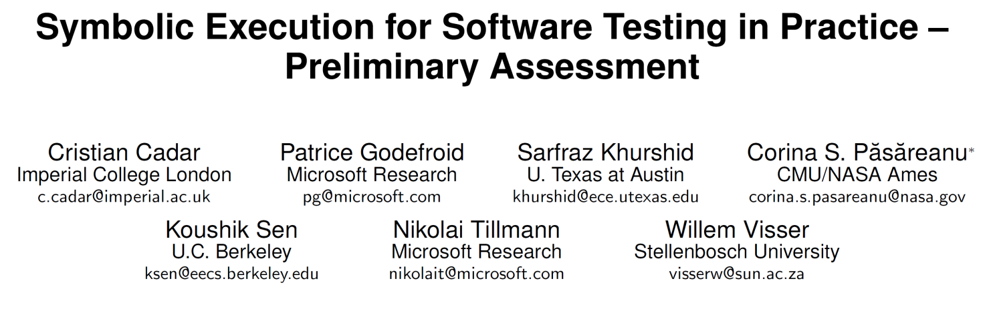

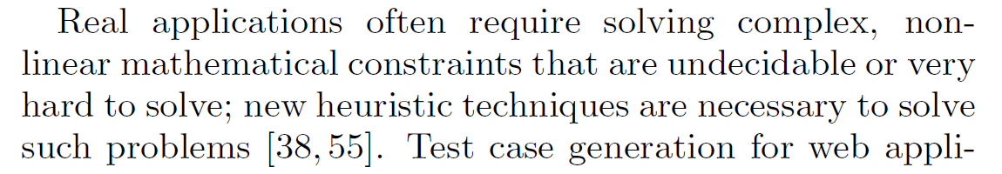
ICSE’11 Impact Project
…
…
M. Souza, M.Borges, M. d’Amorim, and C. Pasareanu. CORAL: Solving Complex Constraints for Symbolic PathFinder. In NFM’11.

Slide 19
CORAL: Constraint solver for complex constraints
Notes:
I will talk about our constraint solver CORAL that makes progress in solving such complex constraints.
<number>

Slide 20
CORAL
Target application of our solver: SE of programs that manipulate floating-point variables
  Use floating-point arithmetic
  Call specific math functions
TSAFE example
Input:
sqrt(pow(((x1 + (e1 * (cos(x4) – …
Output:
{x1=100.0, x2=98.48…, x3=3.08…E-11, …}
Approach: combine meta-heuristic search and interval solving
Notes:
…
The key idea of CORAL is combining two strategies for constraint solving: meta-heuristic search and interval solving.
Next I will elaborate about each one of these and then show how we combined them to improve constraint solving.
<number>

Slide 21
Meta-Heuristic Search
{x1=100.0, x2=98.48…, x3=3.08…E-11, …}
Local
  Uses one single candidate solution
  E.g., Alternating Variable Method (AVM),
  hill climbing, simulated annealing, etc.
Global
  Uses several candidate solutions
  E.g., Particle Swarm Optimization (PSO),
  genetic algorithms, etc.
Notes:
****************
Meta-heuristic search is popular method for finding solution to combinatorial problems.
There are two main modes: local and global search.
****************
Explain what we mean by candidates
Explain what we mean by fitness and “best candidates”
Two key components:
The search that defines how this loop works. there are several variations for that.
The fitness function, which defines how to measure quality of candidates
<number>

Slide 22
Meta-Heuristic Search
{x1=100.0, x2=98.48…, x3=3.08…E-11, …}
Local
  Uses one single candidate solution
  E.g., Alternating Variable Method (AVM),
  hill climbing, simulated annealing, etc.
Global
  Uses several candidate solutions
  E.g., Particle Swarm Optimization (PSO),
  genetic algorithms, etc.
Notes:
Explain what we mean by candidates
Explain what we mean by fitness and “best candidates”
Two key components:
The search that defines how this loop works. there are several variations for that.
The fitness function, which defines how to measure quality of candidates
<number>

Slide 23
Alternating Variable Method (AVM)
Example constraint: sqrt(pow(x1,2)+x2)<5 & x1>0 & x2>0
Start from a random position in the search space
x2-value
25
0
0
5
x1-value
Notes:
Let me show you how the AVM method works.
Please keep in mind that this is a really simple constraint that could be solved analytically.
I use that to facilitate illustration.
<number>

Slide 24
Alternating Variable Method (AVM)
Example constraint: sqrt(pow(x1,2)+x2)<5 & x1>0 & x2>0
Choose variable (in this case x1) and move candidate in both directions
x2-value
25
0
0
5
x1-value

Slide 25
Alternating Variable Method (AVM)
Example constraint: sqrt(pow(x1,2)+x2)<5 & x1>0 & x2>0
Decide which one is best. Need a function to estimate distance.
y-value
25
0
0
5
x1-value
Adapted SAW [T. Back et al., 1998]

Slide 26
Alternating Variable Method (AVM)
Example constraint: sqrt(pow(x1,2)+x2)<5 & x1>0 & x2>0
x2-value
Alternate variable at each step
25
0
0
5
x1-value

Slide 27
Alternating Variable Method (AVM)
Example constraint: sqrt(pow(x1,2)+x2)<5 & x1>0 & x2>0
x2-value
25
0
0
5
x1-value

Slide 28
Alternating Variable Method (AVM)
Example constraint: sqrt(pow(x1,2)+x2)<5 & x1>0 & x2>0
x2-value
25
0
0
5
x1-value

Slide 29
Alternating Variable Method (AVM)
Example constraint: sqrt(pow(x1,2)+x2)<5 & x1>0 & x2>0
x2-value
25
0
0
5
x1-value

Slide 30
Alternating Variable Method (AVM)
Example constraint: sqrt(pow(x1,2)+x2)<5 & x1>0 & x2>0
x2-value
25
0
0
5
x1-value

Slide 31

Alternating Variable Method (AVM)
Example constraint: sqrt(pow(x1,2)+x2)<5 & x1>0 & x2>0
x2-value
25
0
0
5
Solution found!
x1-value

Slide 32
Alternating Variable Method (AVM)
Example constraint: sqrt(pow(x1,2)+x2)<5 & x1>0 & x2>0
x2-value
25
Note: it can get stuck in local maxima and miss solutions!
0
0
5
x1-value
Notes:
Note this is a simple illustrative example.
In fact, it could be easily solved analytically.
In practice, constraints can be more complex than this.
It is also important to note that the method can miss solutions!
For example, it can get lost in local maxima.
This is what this light blue region shows. Conceptually, the candidate will not be able to leave this region since points immediately outside (in the frontier of this region) have a worse distance estimate. But there is no solution inside this region.
<number>

Slide 33
Particle Swarm Optimization (PSO)
Example constraint: sqrt(pow(x1,2)+x2)<5 & x1>0 & x2>0
Uses multiple candidate inputs
x2-value
25
0
0
5
x1-value

Slide 34
Particle Swarm Optimization (PSO)
Example constraint: sqrt(pow(x1,2)+x2)<5 & x1>0 & x2>0
Uses multiple candidate inputs
x2-value
25
0
0
5
x1-value

Slide 35
Interval Solving (IS)
Another method of constraint solving
Applications in several domains
  E.g., stability in control systems
Input:
sqrt(pow(((x1 + (e1 * (cos(x4) – …
Output:
{x1=[99.9…, 100.0], x2=[99.9…, 100.0], …}, …
interval solution
(polyhedra)
Unfortunately, interval solutions may not contain point solutions!

Slide 36
Notes on IS
Output:
{x1=[99.9…, 100.0], x2=[99.9…, 100.0], …}, …
Output of an IS consists of several interval solutions (/polyhedra)
The union of all polyhedra includes all solutions
IS typically reports the first polyhedra quickly but it may not contain solution

Slide 37
Intervals and Point solutions (1)
Space denoted by intervals
Solution space
Search space

Slide 38
Intervals and Point solutions (2)
Space denoted by intervals
We do not assume that the solution space is included in reported intervals
Search space

Slide 39
Intervals and Point solutions (3)
b
Space denoted by intervals
Solution space
Search space

Slide 40
Summary Notes on IS for SE
Interval solvers compute intervals,
not point solutions
…and often point solutions are not trivially extracted from intervals.
Symbolic Execution needs point solutions!

Slide 41
Our Approach: Combine Techniques
Meta-heuristic search
Interval solving
Good for finding exact solutions in large search spaces
But may get lost in local maxima
Good for computing parts of solution space
But does not compute solutions
Seed meta-heuristic search
with inputs drawn from intervals
(intuition: better initial states)

Slide 42
Our hypothesis
Space denoted by intervals
Solution space
Our hypothesis is that this distance is small
Search space

Slide 43

Our combination: IS + AVM
Space denoted by intervals
Solution space
Search space

Slide 44
Our combination: IS + AVM
Space denoted by intervals
Solution space
Search space

Slide 45
Our combination: IS + AVM
Space denoted by intervals
Solution space
Search space

Slide 46
Our combination: IS + PSO
Space denoted by intervals
Solution space
Search space

Slide 47
Our combination: IS + PSO
Space denoted by intervals
Solution space
Search space

Slide 48
Our combination: IS + PSO
Space denoted by intervals
Solution space
Search space

Slide 49
Our combination: IS + PSO
Space denoted by intervals
Solution space
Search space

Slide 50
Implementation
For meta-heuristic search
  Uses Opt4J (http://opt4j.sourceforge.net/)
For interval solving
  Uses RealPaver (RP) [Granvilliers & Benhamou, 2006]
Also includes several optimizations
  E.g., inference of variable domains, elimination of dependent variables, etc.
Notes:
<number>

Slide 51
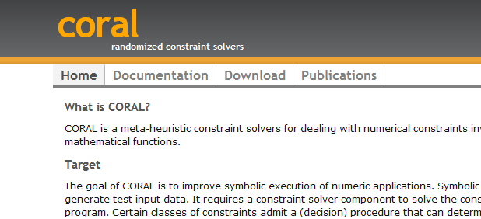
Tool
Integrated with NASA’s Symbolic PathFinder (SPF)
Also available as a library
http://pan.cin.ufpe.br/coral

Slide 52
EVALUATION

Slide 53
Subjects
Previously evaluated CORAL with several subjects
  Many data-structures, benchmark with many constraints provided by NASA, private PISCES lib, etc.
ICST’12 paper focused on (few) publicly available applications from the aerospace domain
TSAFE units
Notes:
<number>

Slide 54
Configurations of CORAL Considered
Meta-heuristic search alone
  AVM
  PSO (previously found it better than GA)
Interval solving (IS) alone
  RP + RAN (choose random values from interval)
Combinations of IS with local and global search
  RP + AVM
  RP + PSO
RP is for RealPaver, our interval solver implementation

Slide 55
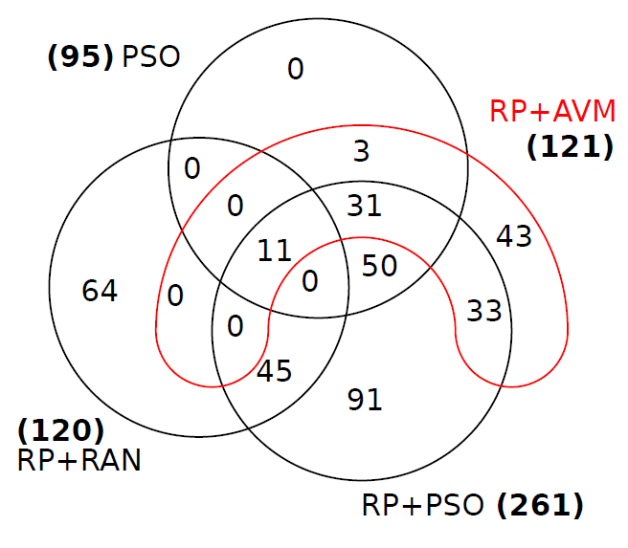
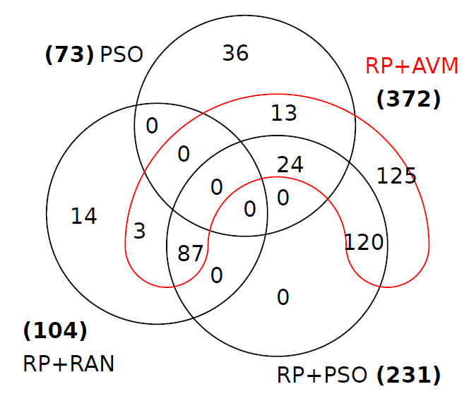
Results for Apollo and CDx
800 constraints considered for each subject, but not all are known to be SAT
APOLLO
CDx
Notes:
This Venn diagram shows the number of constraints solved by each solver.
The numbers beside the labels of the solvers indicate the total number of constraints solved.
For example, …
Note that for Apollo RP+PSO performed better
but for CDx RP+AVM performed better and effectively subsumed RP+PSO
There was no clear winner overall but the use of interval solving was highly effective (I will show this more clearly shortly).
<number>

Slide 56
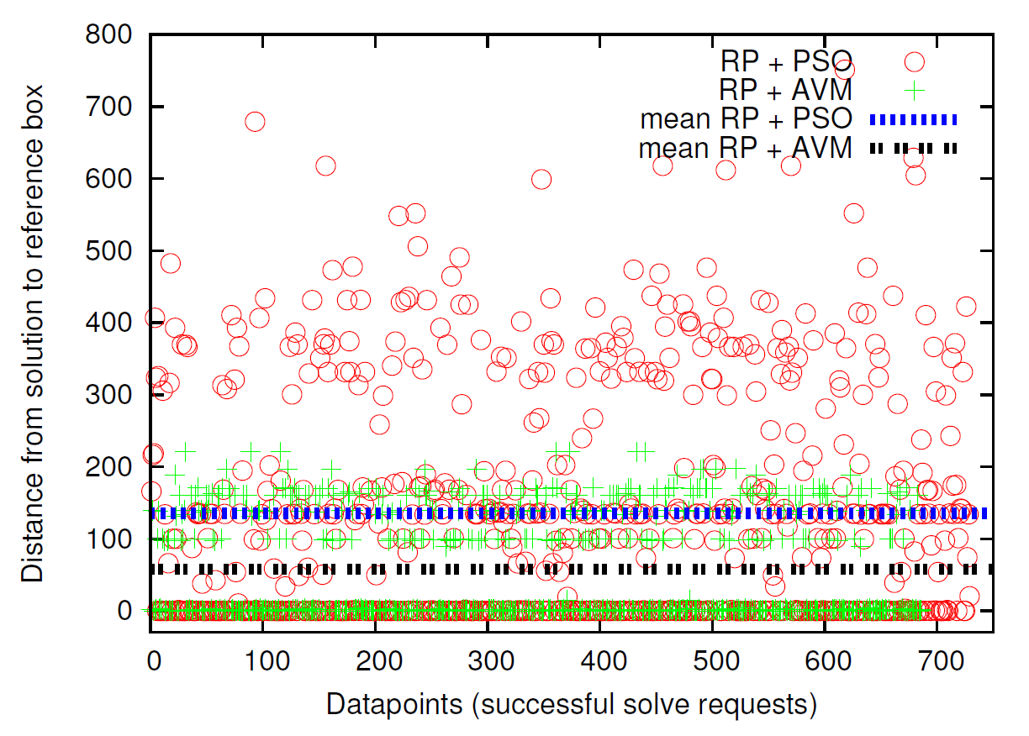
Distance to Solution
Notes:
This plot shows the distance from one solution to the reference interval used in search.
Circle denotes the RP+PSO combination
And Plus denotes RP+AVM combinations
These lines indicates averages of distance across all solutions found for each of these combinations
<number>

Slide 57
Distance to Solution
Many solutions within intervals
Notes:
Note that many solution are indeed inside the intervals
<number>

Slide 58
Distance to Solution
RP+AVM solutions closer to intervals than RP+PSO
Notes:
But we have been able to find several solutions outside.
Note that RP+AVM are closer to the intervals compared to RP+PSO as that algorithm starts a new search after a while
<number>

Slide 59
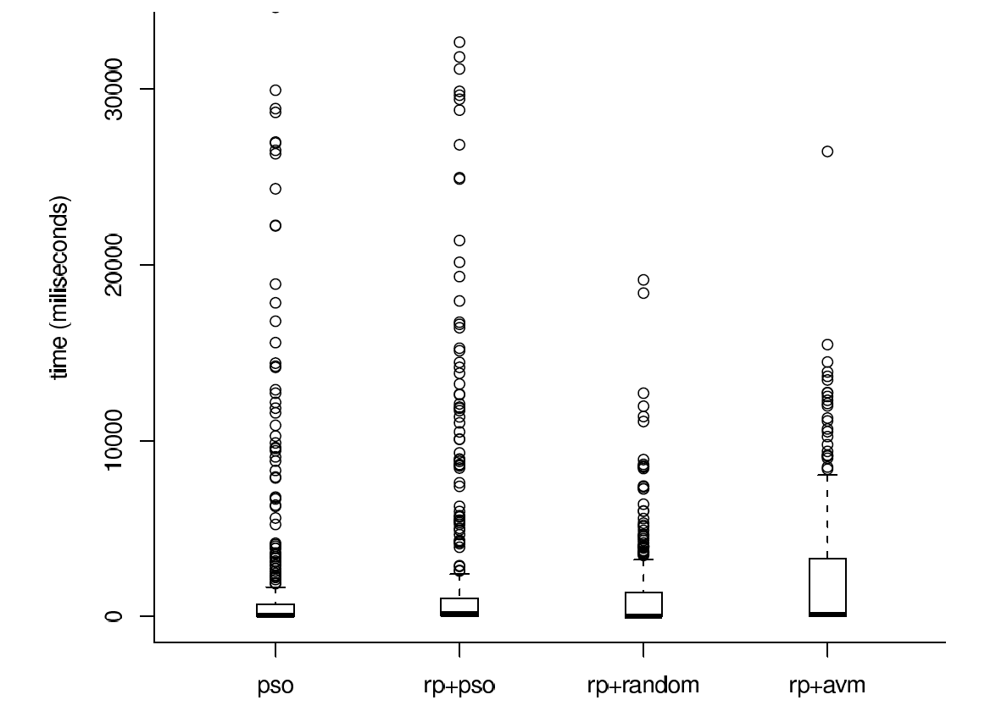
Time for Successful Cases
Small impact on time
Most solutions found are found quickly
Notes:
This plot shows that the impact on time was small and
that most solutions are found very quickly.
The plot shows the distributions of time across all experiments for pso and rp+pso.
I used a boxplot notation to represent the distribution; you can see max min and median points (squeezed) in this case.
<number>

Slide 60
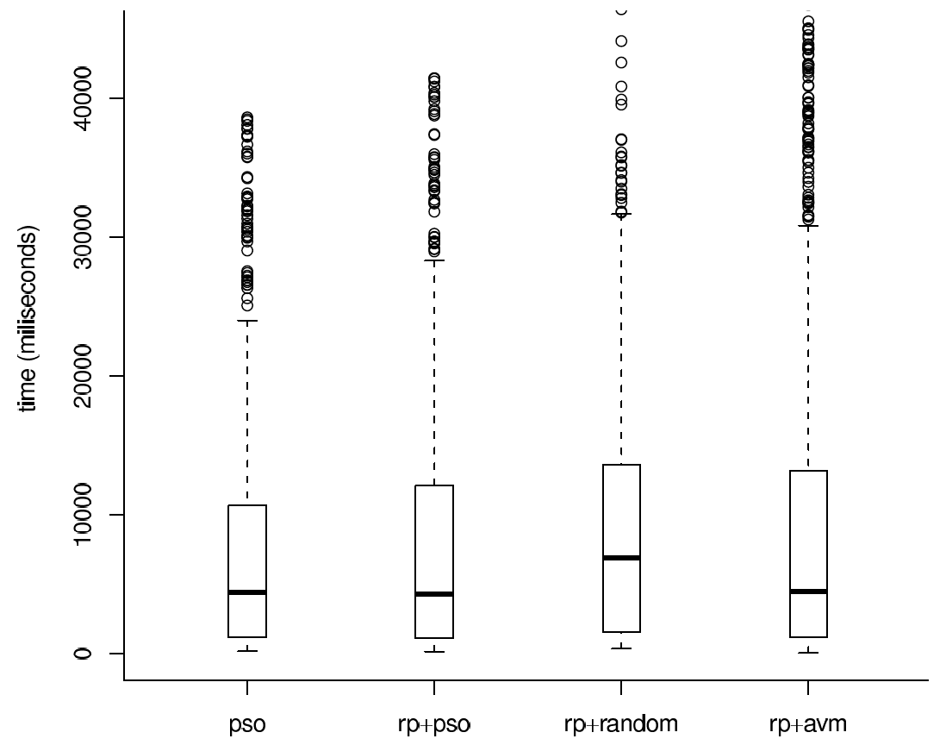
Time for Unsuccessful Cases
Similar time distributions for combinations
Notes:
<number>

Slide 61
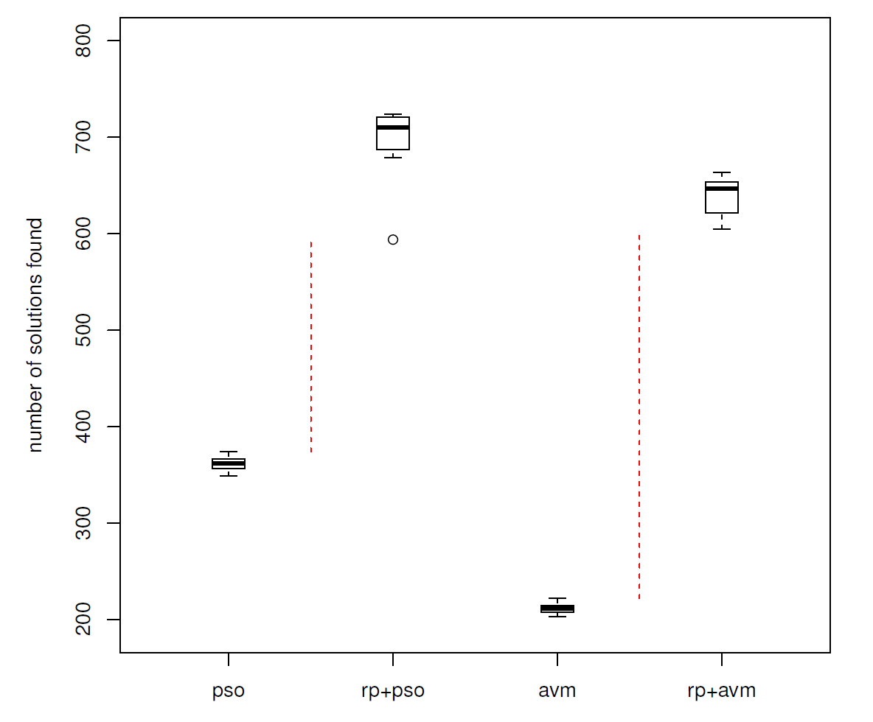
Combinations Substantially Better

Slide 62
Conclusions for CORAL
Combination solved more constraints than meta-heuristic search or interval solving alone
  Both global and local search help interval solving
http://pan.cin.ufpe.br/coral
Notes:
<number>

Slide 63
Closely Related Work
Combining interval solving and SAT solving
  E.g., iSAT [Franzle et al., JSAT’10]
Using meta-heuristic search
  E.g., FLoPSy [Lakhotia et al., ICTSS’10]
Optimizing solving with constraint propagation
  E.g., Choco [Jussien et al., EMNTR’10]
Delegating randomly simplified constraints to decision procedures
  E.g., DART [Godefroid et al., PLDI’05] and EXE [Cadar et al., CCS’06]
Notes:
For the first group the constraint solving problem still persists. If randomization does not work it is necessary to try with a different assignment, which can be very expensive.
For the second group, the main problem is the lack of support for a wide range of operators and math functions.
The advantage of CORAL compared to these is the ability to treat constraints as black boxes.
FlopsY has been developed about the same time as CORAL, with the same goal.
Some differences:
- use of a slightly different fitness functions and search method
no optimizations (such as those mentioned in the beginning)
No integration with interval solving
We did not compare with it, mainly for engineering reasons. It has been developed in C# and to the best of my knowledge (after talking with developers) it is tighly to the PEX infrastructure.
<number>

Slide 64
Future Work for CORAL
Improve CORAL. E.g.,
  Try multiple configurations in parallel
  Model math functions (treated as black box now)
  Consider different interval solvers. E.g., iSAT
Apply CORAL to new domains. E.g.,
  Overflow & round-off errors [Darulova and Kuncak, OOPSLA’11]
  Continuity analysis [Majumdar and Saha, RTSS’09]

Slide 65
Marcelo d’Amorim
http://pan.cin.ufpe.br
Symbolic execution (SE) is an important approach for automating Software Testing
Constraint Solving helps SE
Focus of this talk: how we improve Constraint Solving with CORAL
More generally: My goal is to improve testing and analysis
Notes:
<number>

